Slide 1
Delegates and Events
Asma Kanwal
Lecturer
Department of Computer Science
GC University, Lahore

Slide 2
Delegate
Delegate is a type-safe object that points to another method (or possibly a list of methods) in the application, which can be invoked at a later time. Specifically speaking, a delegate object maintains three important pieces of information:
The address of the method on which it makes calls
The arguments (if any) of this method
The return value (if any) of this method
Once a delegate has been created and provided the necessary information, it may dynamically invoke the method(s) it points to at runtime.

Slide 3
Delegate
Declare a delegate type. A delegate declaration looks like a method declaration, except that it doesn’t have an implementation block.
Declare a delegate variable of the delegate type.
Create an object of the delegate type and assign it to the delegate variable. The new delegate object includes a reference to a method that must have the same signature and return type as the delegate type defined in the first step.
Can optionally add additional methods into the delegate object. These methods must have the same signature and return type as the delegate type defined in the first step.

Slide 4
Delegate
Throughout the code can invoke the delegate, just as it if it were a method. When to invoke the delegate, each of the methods it contains is executed.

Slide 5
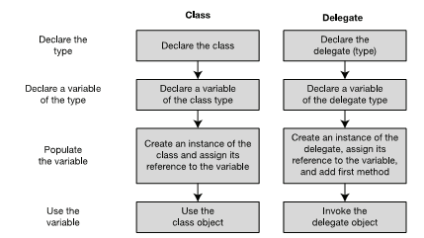
Delegates and Class Similarity

Slide 6
Characteristics of Delegate
The list of methods is called the invocation list .
Methods held by a delegate can be from any class or struct, as long as they match both of the following:
The delegate’s return type
The delegate’s signature (including ref and out modifiers)
Methods in the invocation list can be either instance methods or static methods.
When a delegate is invoked, each method in its invocation list is executed.

Slide 7
Example
// Define a delegate type with no return value and no parameters.
delegate void PrintFunction();
class Test
{
public void Print1()
{ Console.WriteLine("Print1 -- instance"); }
public static void Print2()
{ Console.WriteLine("Print2 -- static"); }
}
class Program
{
static void Main()
{
Test t = new Test(); // Create a test class instance.
PrintFunction pf; // Create a null delegate.
pf = t.Print1; // Instantiate and initialize the delegate.
// Add three more methods to the delegate.
pf += Test.Print2;
pf += t.Print1;
pf += Test.Print2;
// The delegate now contains four methods.
if( null != pf ) // Make sure the delegate isn't null.
pf(); // Invoke the delegate.
else
Console.WriteLine("Delegate is empty");
}
}

Slide 8
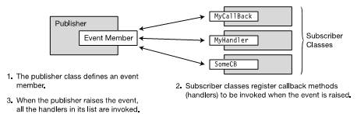
Events
Publishers and Subscribers

Slide 9
Source Code Components
Delegate type declaration: The event and the event handlers must have a common signature and return type, which is described by a delegate type.
Event handler declarations: These are the declarations, in the subscriber classes, of the methods to be executed when the event is raised.
Event declaration: The publisher class must declare an event member that subscribers can register with . When a class declares a public event, it is said to have published the event .

Slide 10
Source Core Components
Event registration : The subscribers must register with an event in order to be notified when it has been raised. This is the code that connects the event handlers to the event.
Code that raises the event: This is the code in the publisher that “fires” the event, causing it to invoke all the event handlers registered with it.

Slide 11
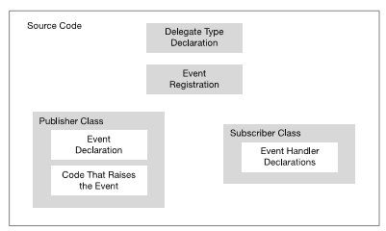
Component Model

Slide 12
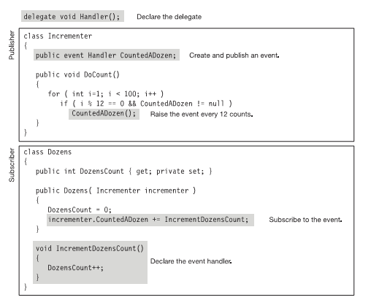
Example

Slide 13
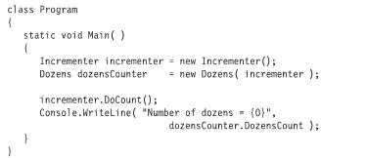
Continue…

